Slide 1
Fraud Prediction in Financial Transactions
Using Machine Learning
Created By: Vivek B. Pal
Designation: Data Scientist
Date: 05/03/2025

Slide 2
Content
Introduction
Exploratory Data Analysis (EDA)
Preprocessing
Feature Selection
Machine Learning Models Used
Model Evaluation & Results
Conclusion

Slide 3
Introduction
This project aims to enhance the accuracy of detecting fraud in mobile financial transactions.
By leveraging machine learning, the project seeks to predict fraudulent transactions with high precision.
The goal is to develop a robust machine learning model to accurately identify fraudulent transactions in real-time, enabling the company to improve security, reduce financial losses, and gain insights into factors contributing to transaction fraud.

Slide 4
Exploratory Data Analysis (EDA):
. Dataset Overview
Total Entries: 11,142 transactions
Total Features: 8 (after removing nameOrig and nameDest)
No MissingA Values: The dataset is complete and clean
No Duplicate Records: Ensures data uniqueness
. Feature Types
Numerical (Float64 - 5 columns): amount, oldbalanceOrg, newbalanceOrg, oldbalanceDest, newbalanceDest
Numerical (Int64 - 2 columns): step (time-related), isFraud (binary target)
Categorical (Object - 1 column): type (transaction type, requires encoding)

Slide 5
Exploratory Data Analysis:
Key Observations:
Class Imbalance: ~10.25% of transactions are fraudulent, requiring resampling techniques to improve model performance.
Transaction Amounts: Highly skewed, with extreme values (mean ≈ 213,000, median ≈ 16,762).
Balance Features: Large differences between means and medians, indicating outliers. Many accounts have zero balances, possibly new or inactive accounts.
Time Feature (step): 95 unique values, representing different time intervals.
Transaction Types (type): 5 unique categories, are potentially influential in fraud detection.
Next Steps for Modeling:
Encoding: Convert type to numerical format.
Feature Engineering: Handle skewed distributions and outliers.
Class Imbalance Handling: Apply oversampling, undersampling, or specialized algorithms (e.g., SMOTE).
Dividing Data Into X and y and Splitting The Data into train_test_split
Modeling Approach: Consider Logistic Regression, SVM, Decision Tree, Random Forest, and Gradient Boosting for fraud detection.

Slide 6
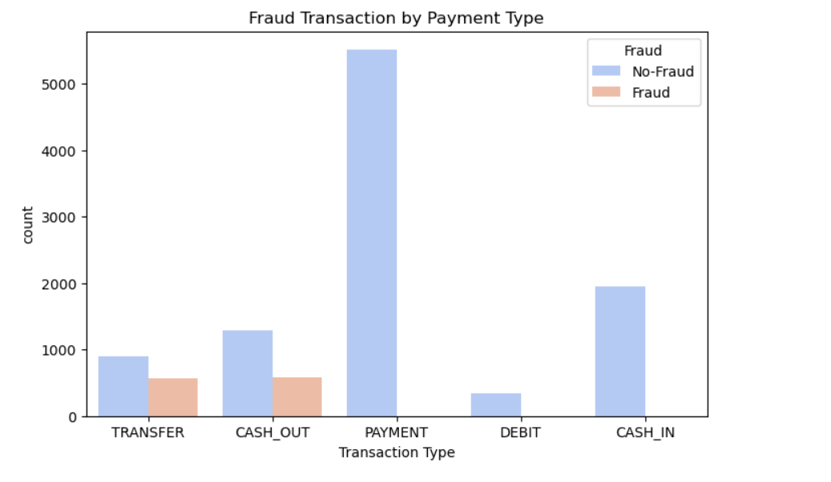
Exploratory Data Analysis (EDA):
Dominance of "PAYMENT" Transactions: "PAYMENT" is the most frequent transaction type, significantly outnumbering other types. This suggests that a large portion of financial activity in this dataset involves payments.
Moderate Frequency of "CASH_OUT" and "CASH_IN": These transaction types occur at a relatively similar rate, indicating a balanced cash flow in and out of accounts.
Lower Occurrence of "TRANSFER": "TRANSFER" transactions happen less frequently than "CASH_OUT" and "CASH_IN," implying that direct money transfers are not as common.
Least Common Transaction - "DEBIT": "DEBIT" transactions appear the least, suggesting that this method of transaction is rarely used.

Slide 7
Preprocessing:
Before training machine learning models for fraud detection, we performed several preprocessing steps to clean and prepare the data. Proper preprocessing ensures better model performance and reduces bias in predictions.
1. Handling Missing Values
Checked for missing or incomplete data in transaction records.
Used mean/median imputation for numerical values and mode imputation for categorical values if necessary.
2. Feature Engineering
Created new features to enhance fraud detection, such as:
Transaction Impact on Balance:
Net Transaction Effect
High-Value Transactions
3. Encoding Categorical Variables
Used One-Hot Encoding or Label Encoding to convert categorical features (like transaction type) into numerical format for machine learning models.
4. Handling Imbalanced Data
Fraud detection datasets are often highly imbalanced (few fraud cases compared to normal transactions).
Applied oversampling (SMOTE) to increase fraud cases or undersampling to balance the dataset.
5. Feature Scaling
Applied Min-Max Scaling or Standardization to normalize numerical features like transaction amount, ensuring models learn effectively.
6. Splitting Data
Divided the dataset into training and testing sets (e.g., 70% training, 30% testing) to evaluate model performance on unseen data.
By applying these preprocessing techniques, we ensured that our models received clean, balanced, and meaningful data, leading to better fraud detection accuracy and reliability.

Slide 8
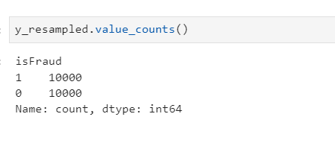
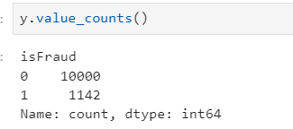
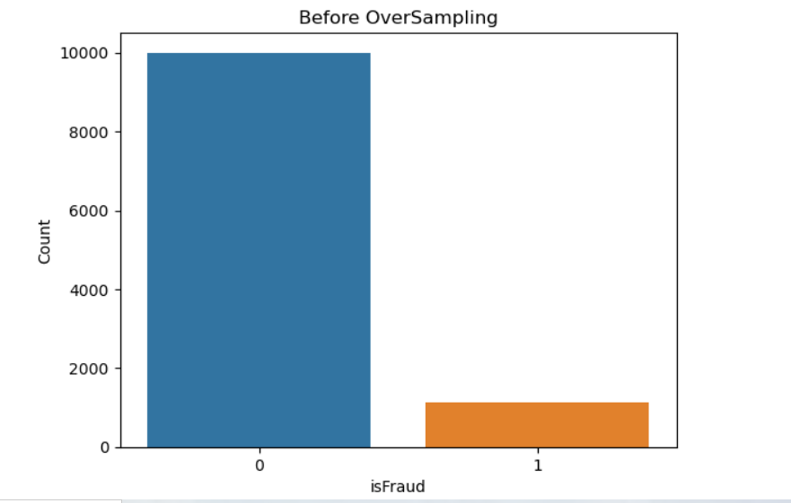
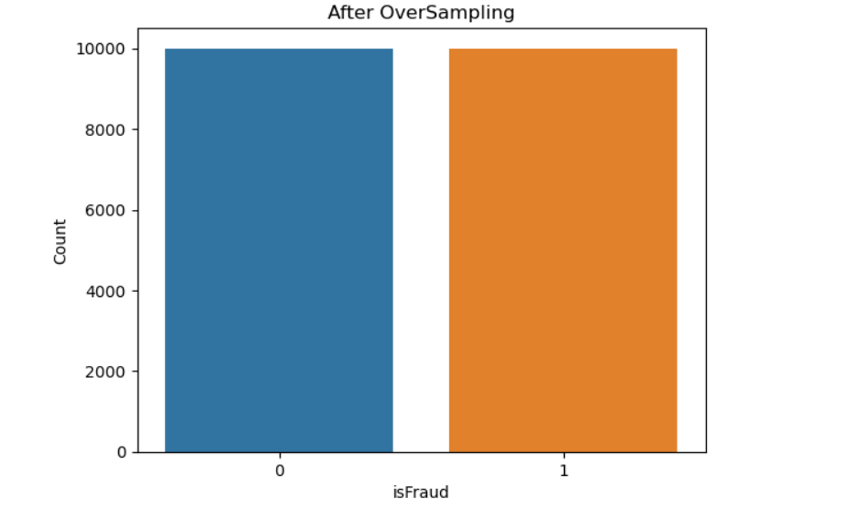
Handling imbalancing :Oversampling(SMOTE)

Slide 9
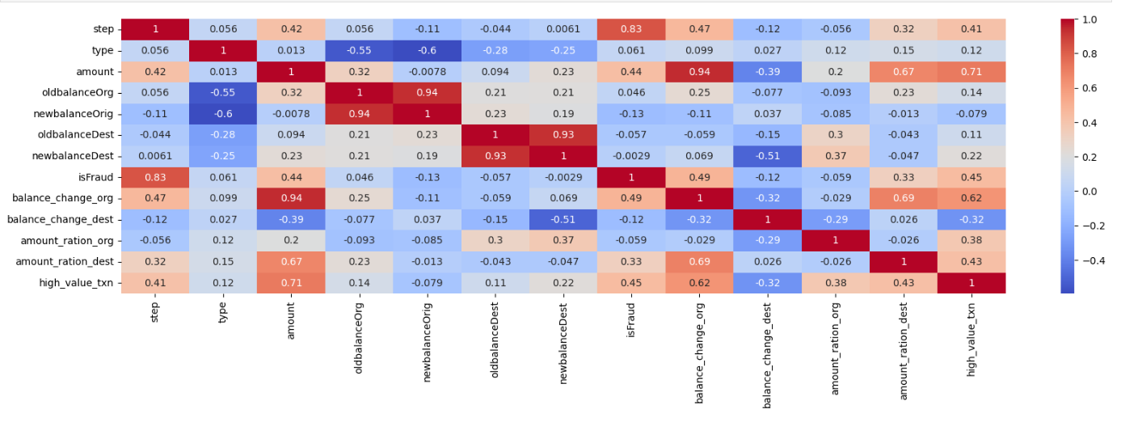
Feature Selection:

Slide 10
Model Selection :
In this problem, I have a target feature, which indicates that it is a supervised learning problem.
The target feature, `isFraud`, consists of binary classes, so I will use logistic regression. This method is suitable because it helps determine the best-fit line between the two values.
Support Vector Machines (SVMs) are effective in high-dimensional spaces and are robust against overfitting, especially when there are clear separation margins between classes.
A Decision Tree is a simple yet powerful model that splits data into branches based on feature conditions. It is easy to interpret and can capture complex decision boundaries.
Ensemble Method: As an ensemble of decision trees, `Random Forest` improves predictive accuracy and helps control overfitting. It builds multiple decision trees during training and combines their predictions.
Gradient Boosting is a powerful ensemble learning technique that constructs multiple weak decision trees sequentially. Each tree corrects the errors of the previous one, improving predictive accuracy by minimizing errors step by step. This method is highly effective in detecting fraud.

Slide 11
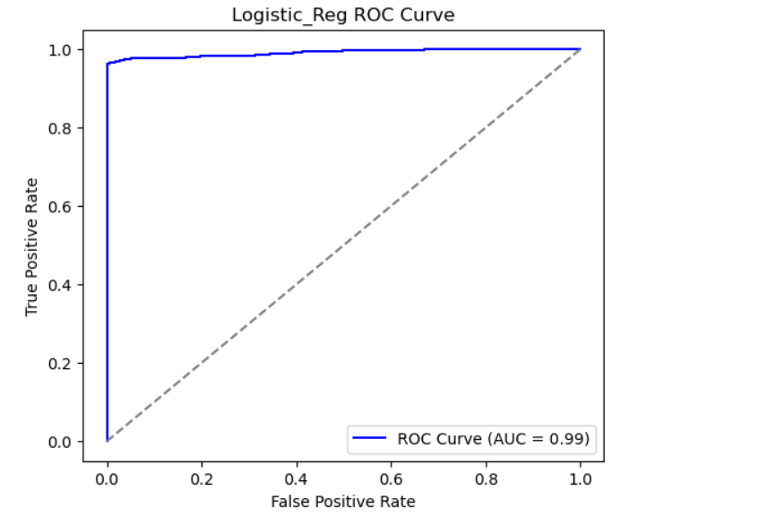
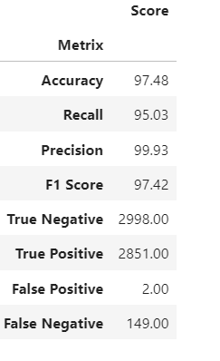
1. Logistic Regression:

Slide 12
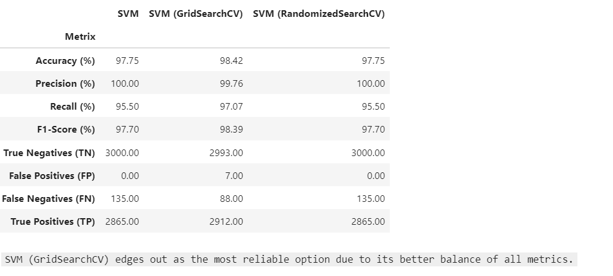
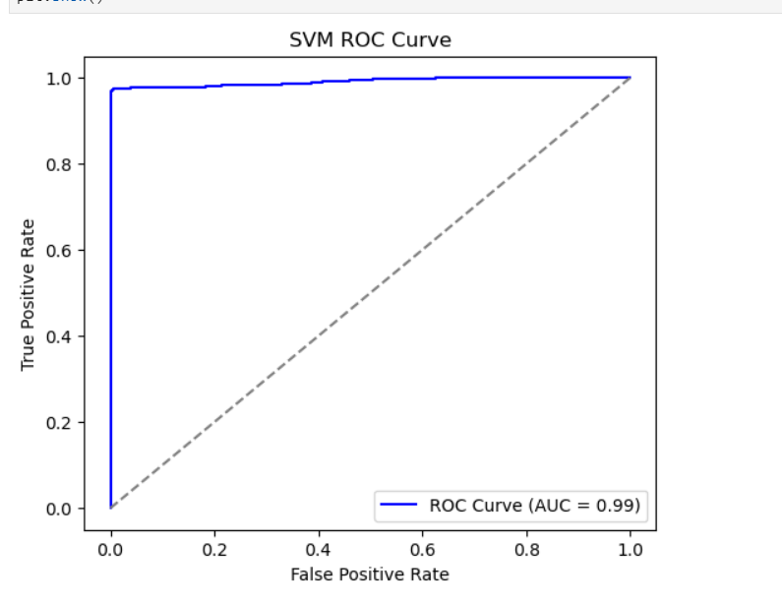
2. Support Vector Classifier:

Slide 13
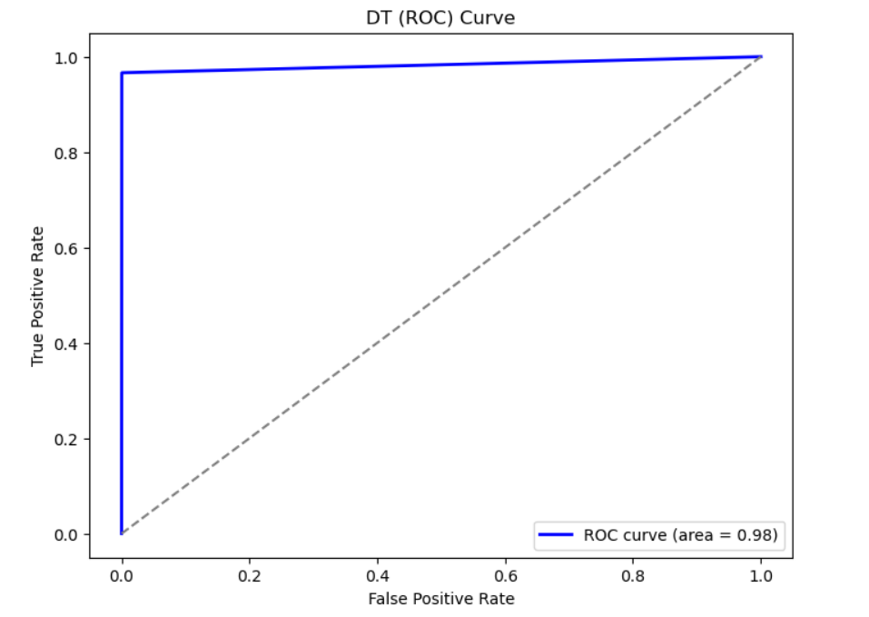
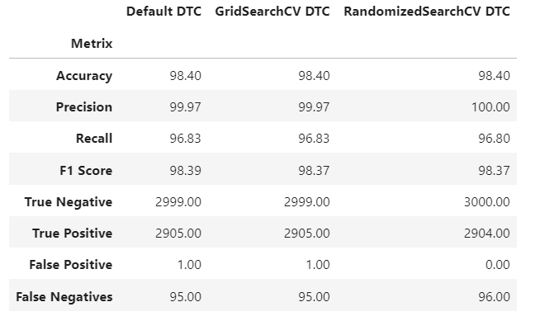
3. Decision Tree Classifier:

Slide 14
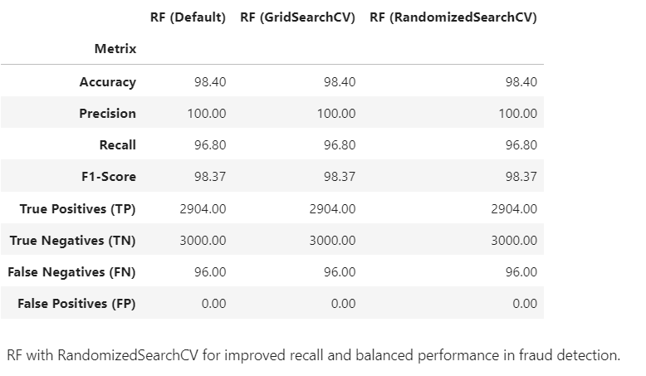
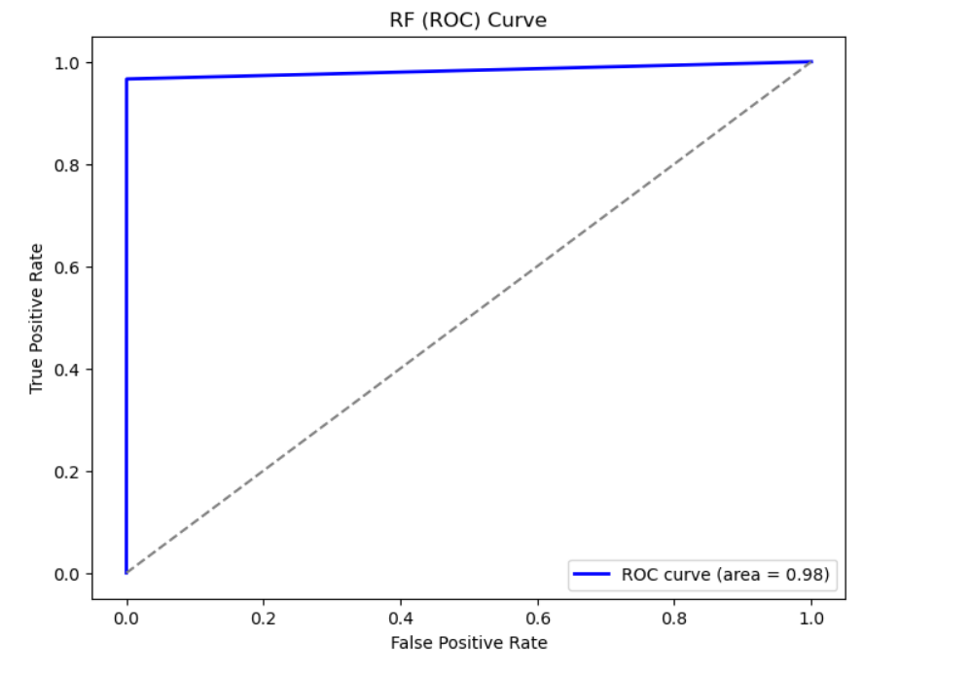
4. Random Forest Classifier:

Slide 15
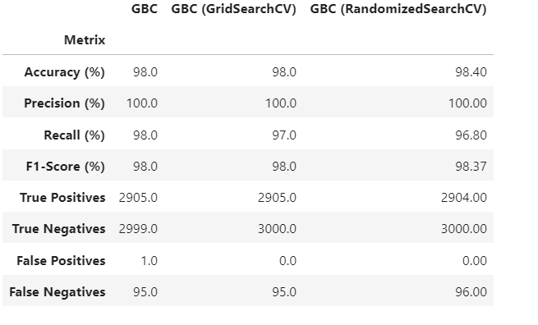
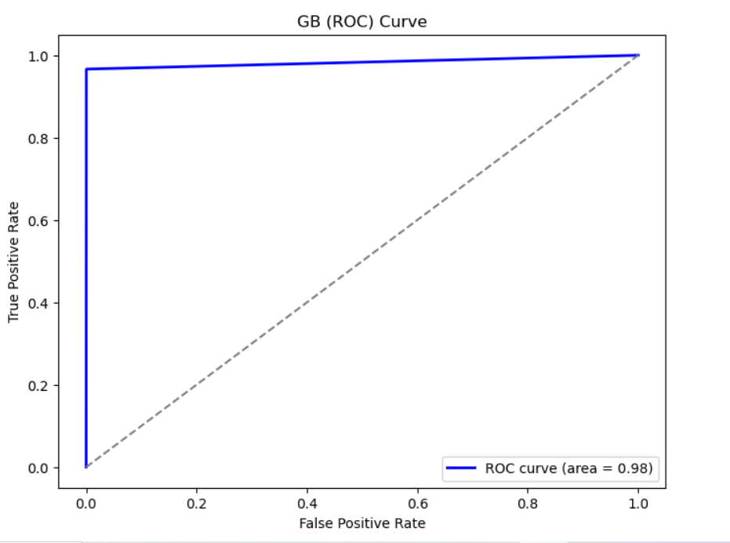
5. Gradient Boosting Classifier:

Slide 16
Business Questions to Address:
1. What is the model's precision and accuracy in detecting fraudulent transactions?
Precision: The best models (Random Forest, Gradient Boosting, and SVM) achieved 100% precision, meaning that when they classify a transaction as fraudulent, they are almost always correct.
Accuracy: The highest accuracy was 98.42% (SVM with GridSearchCV), followed closely by 98.40% (Random Forest, Decision Tree, and Gradient Boosting).
F1-Score: The best F1-score was 98.39% (SVM with GridSearchCV) and 98.0% (Gradient Boosting), indicating a strong balance between precision and recall.

Slide 17
Business Questions to Address:
2. How reliable is the model in classifying transactions as legitimate or fraudulent?
Recall (Fraud Detection Rate):
SVM with GridSearchCV (97.07%) had the highest recall, meaning it successfully detected 97.07% of all fraud cases.
Gradient Boosting (98%) was also highly reliable in detecting fraudulent transactions.
False Negatives (Missed Fraud Cases):
SVM with GridSearchCV (88 FN) had the lowest false negatives, making it the most reliable in catching fraudulent transactions.
Gradient Boosting (95 FN) and Random Forest (96 FN) also performed well.
False Positives (Incorrect Fraud Classifications):
Random Forest and Gradient Boosting (after tuning) had 0 false positives, meaning they did not wrongly classify legitimate transactions as fraud.
SVM (Default & RandomizedSearchCV) also had 0 false positives, ensuring that genuine customers are not wrongly flagged.

Slide 18
3. Potential Losses Due to Model Errors (with Financial Calculations)
False Positives (FP) Impact:
Business Consequence: If a legitimate transaction is wrongly flagged as fraud, customers may face inconvenience, potentially leading to dissatisfaction, lost sales, and customer churn.
Model Analysis: Since Random Forest, Gradient Boosting, and SVM (Default & RandomizedSearchCV) had 0 FP, the risk of blocking genuine transactions is minimal.
False Negatives (FN) Impact:
Business Consequence: A false negative means a fraudulent transaction was missed, leading to direct financial loss for the company.
Loss Estimation:
Let’s assume the average fraud transaction amount is $500.
The total number of false negatives (missed fraud cases) for each model:
SVM (GridSearchCV): 88 FN
Gradient Boosting (GBC): 95 FN
Random Forest (RF): 96 FN
Business Questions to Address:
Model | False Negatives (FN) | Estimated Loss ($500 per fraud case)
SVM (GridSearchCV) | 88 | $44,000
Gradient Boosting (GBC) | 95 | $47,500
Random Forest (RF) | 96 | $48,000

Slide 19
Conclusion:
I tested different machine learning models to find the best one for fraud detection by looking at accuracy, precision, recall, and error rates.
Best for catching fraud: SVM (GridSearchCV) detected the most fraud cases, missing only 88 frauds and reducing losses to $44,000.
Best for avoiding false alarms: Random Forest and Gradient Boosting had 0 false positives, meaning no real transactions were wrongly blocked.
Choosing the right model depends on business needs:
Want to catch the most fraud? Go with SVM (GridSearchCV).
Want to balance fraud detection while keeping customers happy? Choose Random Forest or Gradient Boosting.
Picking the right model will help reduce financial losses, improve security, and keep customers satisfied.

Slide 20
Thank You!

